Slide 1
Design And Analysis of Algorithms
Vertex splitting in directed acyclic graph

Slide 2
ABSTRACT
In the vertex splitting problem, the objective is to determine a minimum number of vertices from the graph to split such that the resulting graph has no path of length greater than a given δ.
The problem has been proven to be NP-hard. A Genetic Algorithm is used to solve the DAG Vertex Splitting Problem.
This approach uses a variable string length to represent the vertices that split the graph and a dynamic population size

Slide 3
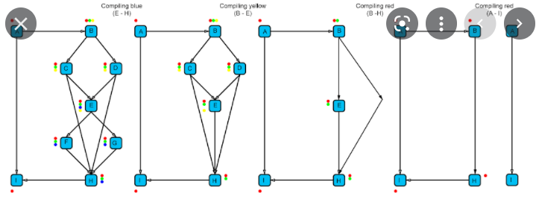
PROBLEM STATEMENT AND DOMAIN
First we have to create a directed acyclic graph than we have to split the vertex's of the graph by using Genetic Algorithms

Slide 4
EXISTING SOLUTIONS/NAÏVE SOLUTIONS
We can use Genetic Algorithms for vertex splitting
Basically, the algorithm works as follows
1) try to find a suboptimal solution by splitting x vertices
2) if a suboptimal solution is found, reduce the number o f vertices and try again
3) if no solution has been found within a certain number of generations, expand the
number o f vertices and try again

Slide 5
equation
Let G = (V, E, w) be a weighted directed acyclic graph (WDAG) with vertex set V, edge
2
set E, and edge function w. w(i, j) is the weight of the edge <i, j> e E. w(i, j) is a positive
real number for <i, j> e E and is undefined if <i, j> £ E. The delay, d(P), on the path P, is
the sum of the weights of all the edges on that path. The delay, d(G), of the graph G is the
maximum path delay in the graph.

Slide 6
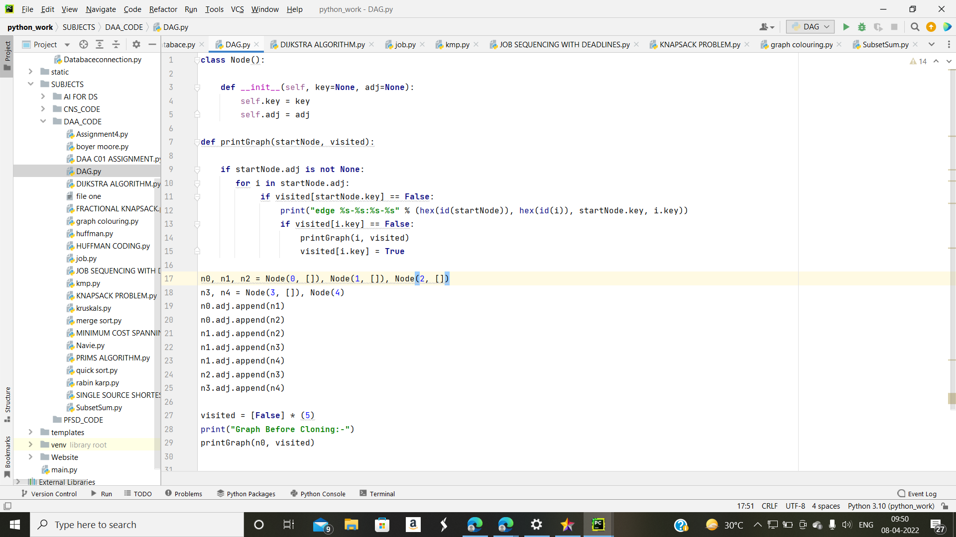
Solution strategy- Algorithm used

Slide 7
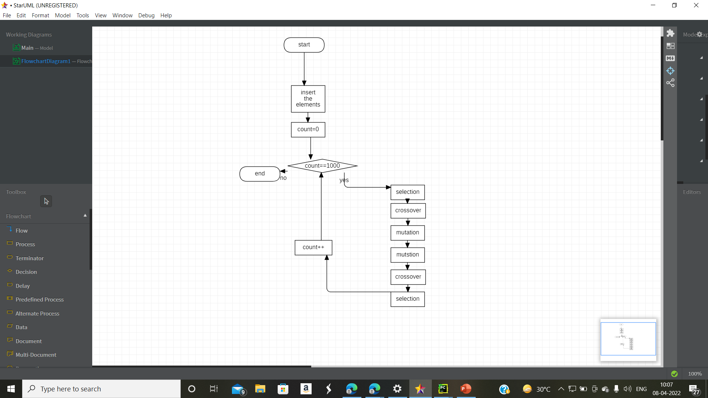
FLOWCHAT

Slide 8
Hardware and Software used
Directed acyclic graph, vertex splitting, genetic algorithms, variable string length , dynamic population size, NP-hard, Pycham

Slide 9
Results
Directed Acyclic Graphs are often used to model circuits and networks. The path length in such Directed Acyclic Graphs represents circuit or network delays. I has many applications in the fields of computer science and electrical engineering.

